Slide 1
Module 6: Troubleshooting SSIS

Slide 3
Agenda
SSDT Features
Progress Reporting
Data Flow - Data Viewer
Break Points
Watch List
Integration Services Dashboard

Slide 4

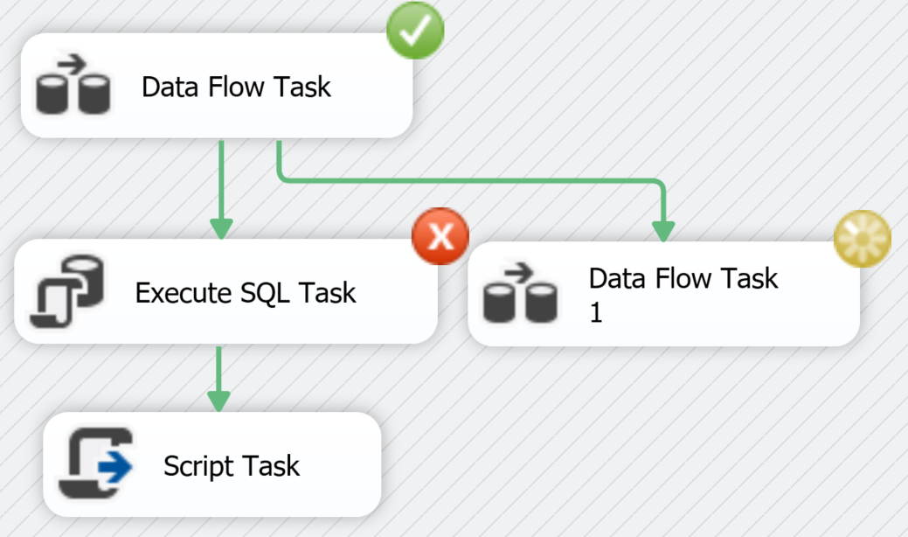


Progress Reporting – task/component states
Visible only when executing the package in SSDT
Progress States are:
Running -
Successfully completed –
Failed –
No color – waiting for execution
Notes:
https://docs.microsoft.com/en-us/sql/integration-services/troubleshooting/debugging-data-flow?view=sql-server-2017

Slide 5
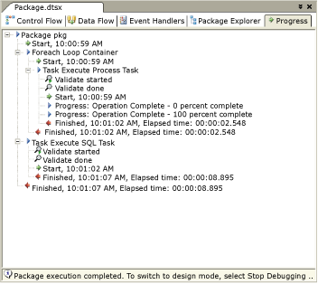
Progress Reporting - messages
Displays informational, warning, and error messages in Progress Tab of SSDT
Percentage completion
Progress of the various phases
Pre-Execute
Validate
Execution
Notes:
https://docs.microsoft.com/en-us/sql/integration-services/troubleshooting/debugging-data-flow?view=sql-server-2017

Slide 6
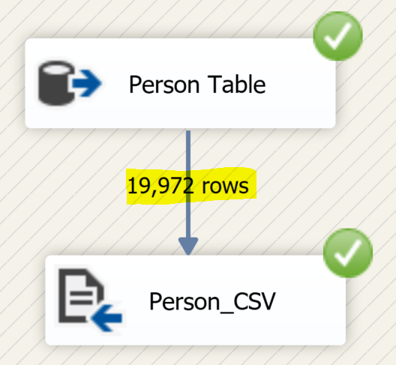
Progress Reporting – Data Flow Row Count
Number of rows that have passed through a path is displayed and is updated progressively
Row counts are visible only when executing the package in SSDT
Notes:
https://docs.microsoft.com/en-us/sql/integration-services/troubleshooting/debugging-data-flow?view=sql-server-2017

Slide 7
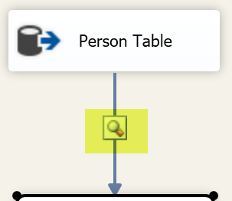
Data Flow - Data Viewer
SSIS Designer feature
Display data between two components in a data flow
Example of uses
display extracted data from a data source
display before and after a transformation
display before the data is loaded into destination
Data viewer results are viewable only when executing the package in SSDT
Notes:
https://docs.microsoft.com/en-us/sql/integration-services/troubleshooting/debugging-data-flow?view=sql-server-2017

Slide 8
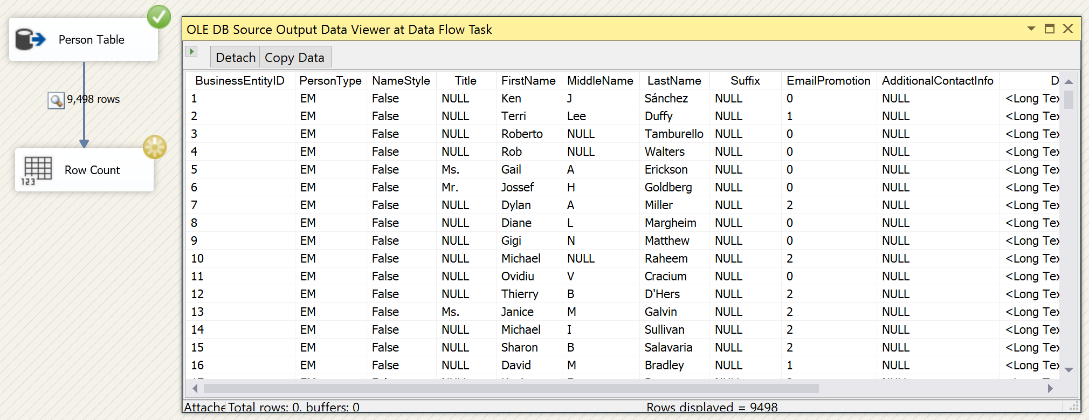
Data Flow - Data Viewer (2)
Displays one buffer at a time.
Play button to proceed to next buffer
Detach – stop data viewer
Attach – start data viewer
Can detach & attach
multiple times while
package is running
Notes:
https://docs.microsoft.com/en-us/sql/integration-services/troubleshooting/debugging-data-flow?view=sql-server-2017

Slide 9
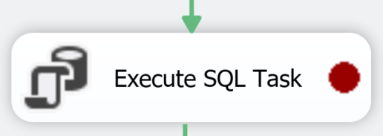
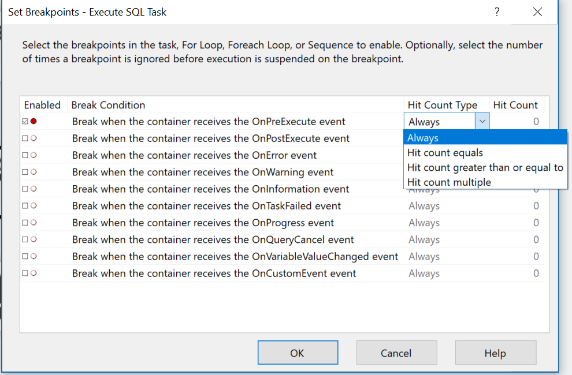
Breakpoints
Set breakpoints by enabling break conditions
Some tasks and containers include special break conditions for setting breakpoints
Eg: can break at start of each For Loop container iteration.
Notes:
https://docs.microsoft.com/en-us/sql/integration-services/troubleshooting/debugging-control-flow?view=sql-server-2017#set-breakpoints

Slide 10
Breakpoints – Hit count
Use Hit Count to modify breakpoint behavior
Hit count type | Description
Always | Execution is always suspended when the breakpoint is hit.
Hit count equals | Execution is suspended when the number of times the breakpoint has occurred is equal to the hit count.
Hit count greater than or equal to | Execution is suspended when the number of times the breakpoint has occurred is equal to or greater than the hit count.
Hit count multiple | Execution is suspended when a multiple of the hit count occurs. For example, if you set this option to 5, execution is suspended every fifth time.
Notes:
https://docs.microsoft.com/en-us/sql/integration-services/troubleshooting/debugging-data-flow?view=sql-server-2017

Slide 11
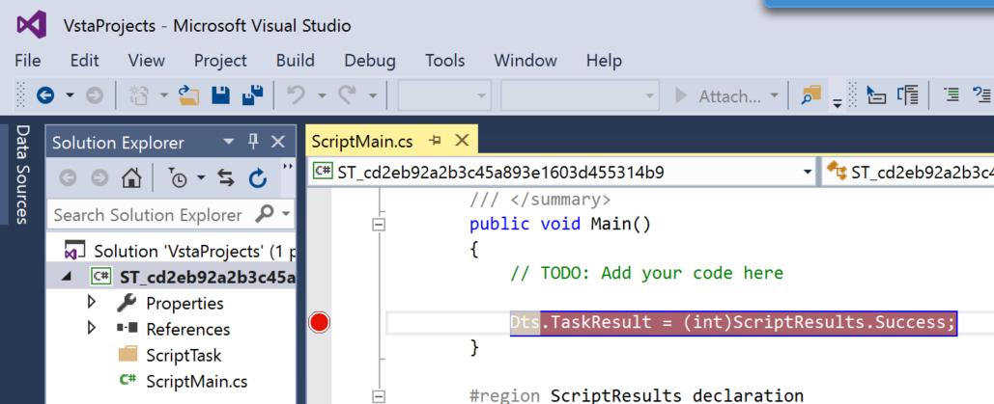
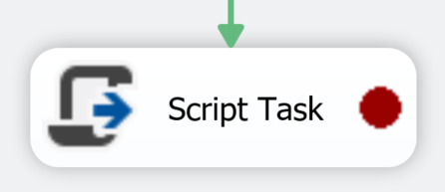
Breakpoints – script task or script component
You can set breakpoints within Microsoft Visual Studio Tools for Applications (VSTA).
can manage the breakpoints in VSTA or also using the Set Breakpoints dialog box that SSIS Designer provides

Slide 12
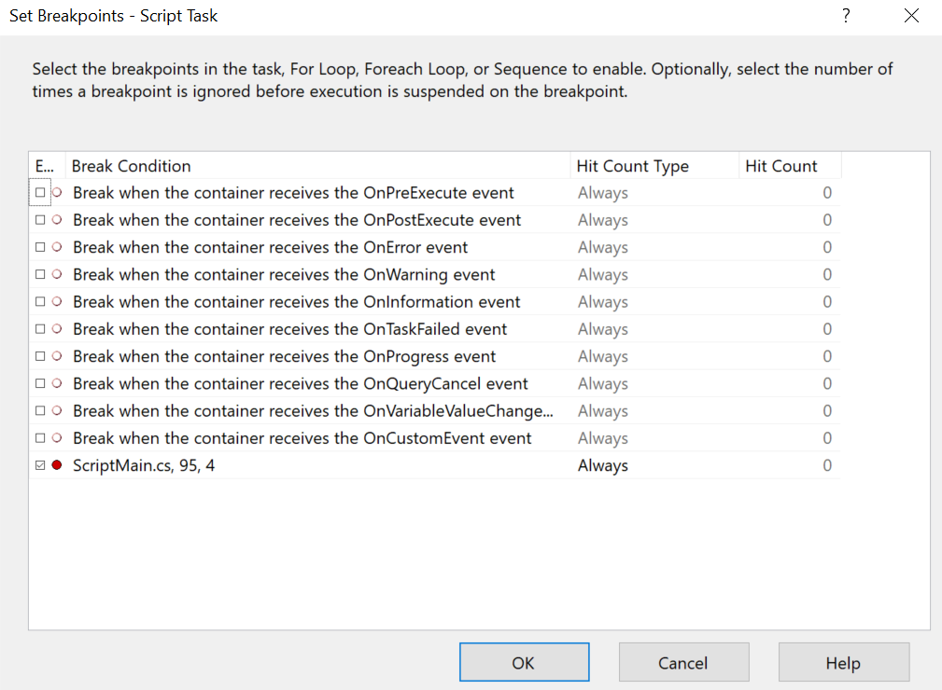
Breakpoints – script task or script component (2)
Set Breakpoints dialog box also includes the script breakpoints
Appear at bottom breakpoint list
display line number and function name where breakpoint appears

Slide 13
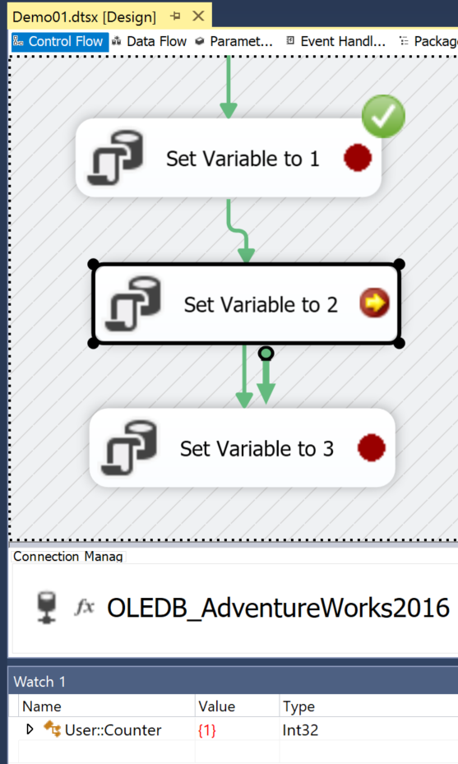
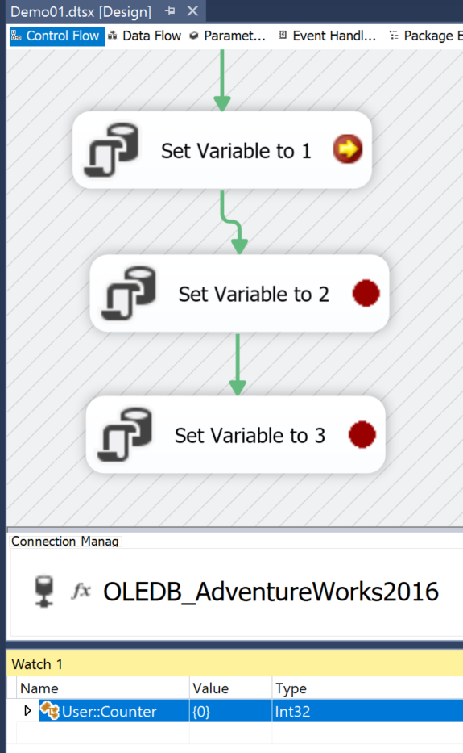
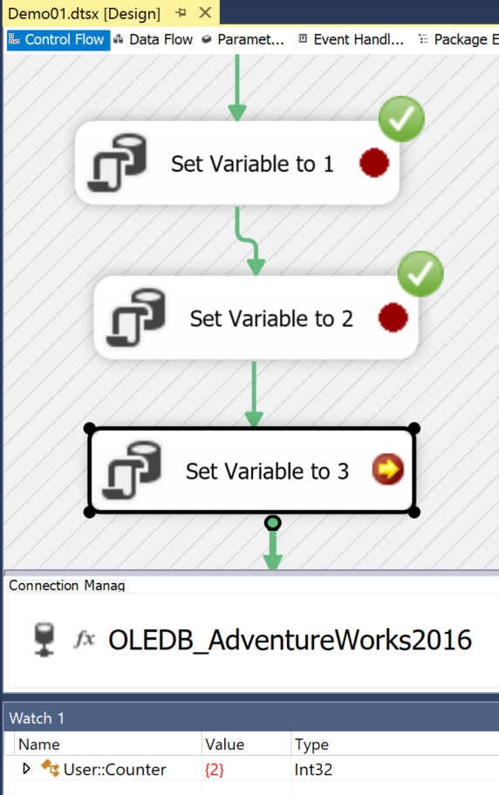
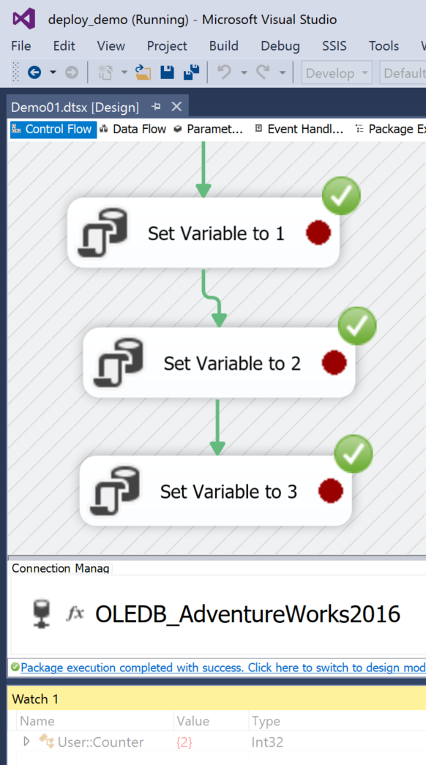
Watch Window
Add SSIS variables (Scope::VariableName) to Watch List when at break to view the variable value
You can set breakpoints and observe variable values before executing the task

Slide 14
Integration Services Dashboard
View current state of packages
Running
Succeeded
Failed
View Error Message for failures
View Parameter values used
Property overrides
Which Environment was used
Duration for each control flow task

Slide 15
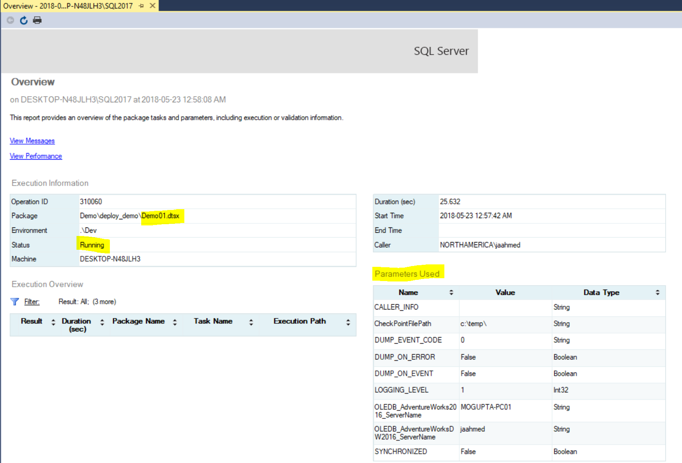
Integration Services Dashboard
Running State

Slide 16
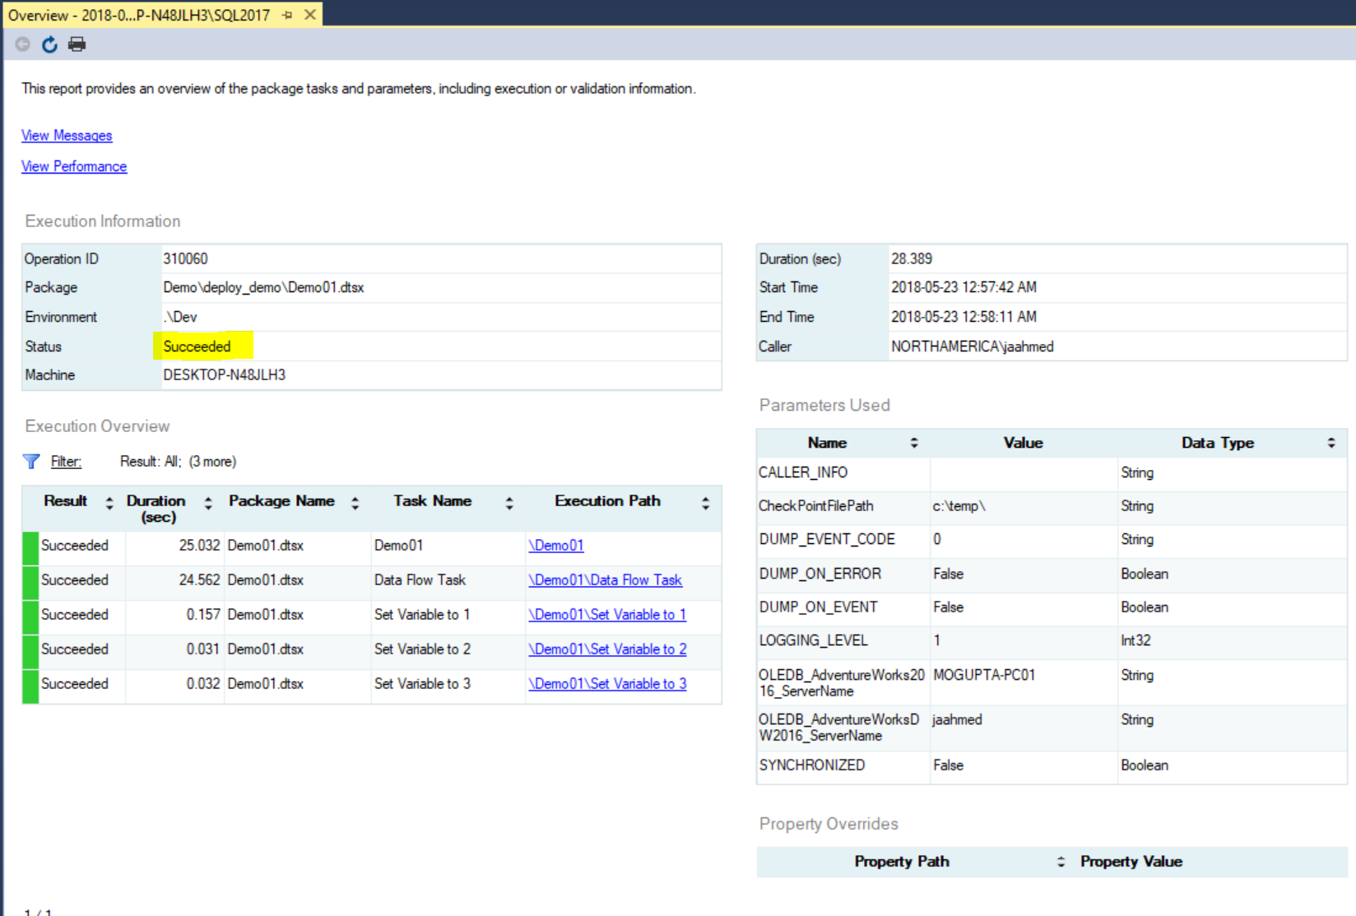
Integration Services Dashboard
Succeeded State

Slide 17
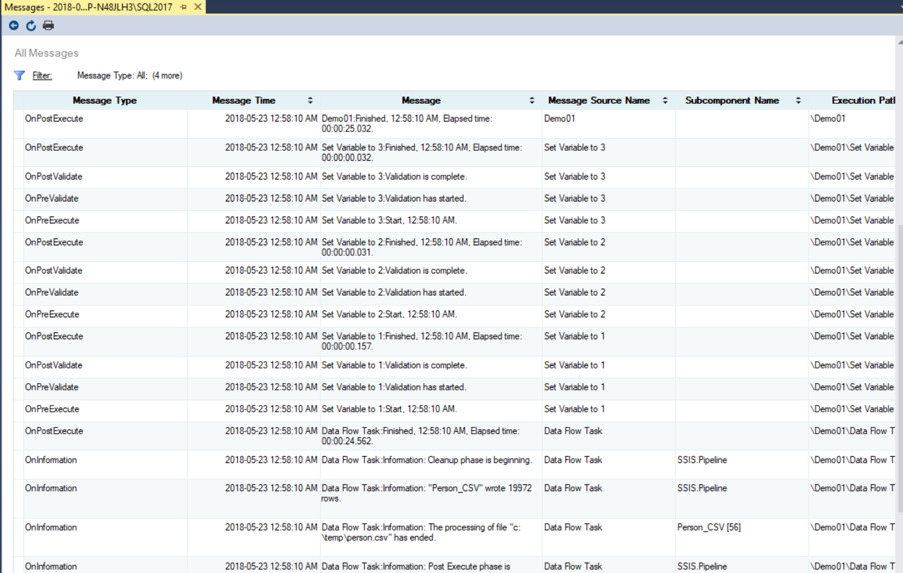
Integration Services Dashboard
View messages similar to the Execution Results Tab in SSDT

Slide 18
SSIS DB Queries
Quick insight on
Running packages,
Performance History
Run outcome
DataFlow statistics and performances
Lookup component memory usage
Lookup component duplicate warnings
Errors
Memory Warnings
Provided queries also used in ssis-dashboard project.
https://github.com/yorek/ssis-queries
Notes:
Ssis-dashboard - provide a web-based, user-friendly, useful and nice looking SQL Server Integration Services Dashboard and a set of REST API to monitor execution of SQL Server Integration Services Packages.
http://ssis-dashboard.azurewebsites.net/

Slide 19
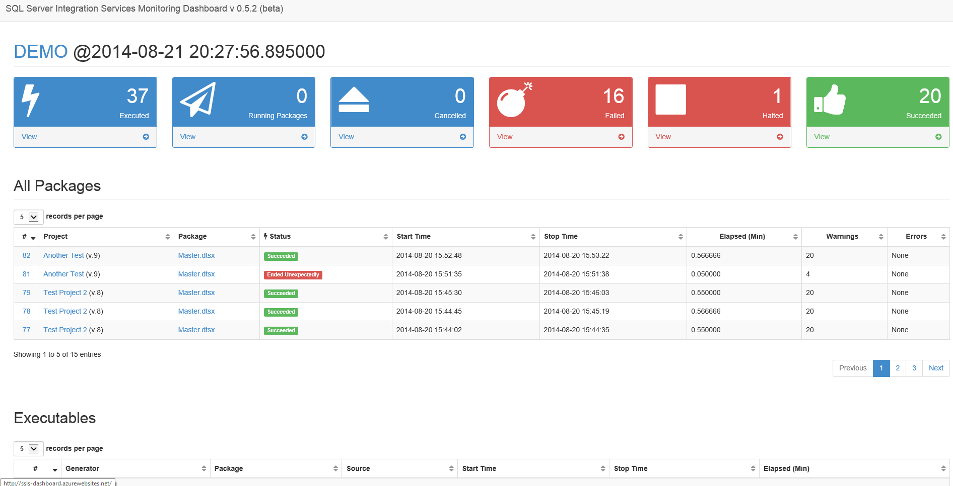
ssis-dashboard project
web-based SQL Server Integration Services Dashboard and a set of REST API to monitor execution of SQL Server Integration Services Packages.

Slide 20
SSISDB Dashboard (PBI Report)
https://github.com/chrschmi/PBI_SSIS
Notes:
https://github.com/chrschmi/PBI_SSIS/raw/master/SSISDB%20Execution.pbit

